Slide 1

Play SQL:
Learning Database Querying using a Game
SIMPSON COLLEGE
Mark Brodie
Department of Computer Science
Simpson College
Indianola, IA 50125
mark.brodie@simpson.edu

Slide 2
Motivation
SIMPSON COLLEGE
Create an app to teach database querying using a game.
The game should:
  Teach how to create SQL queries.
  Require no programming or database experience.
    Yet be useful for both beginners and those with SQL experience.
  Be fun.

Slide 3
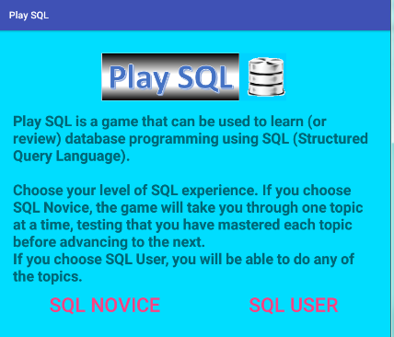
Opening Screen
SIMPSON COLLEGE

Slide 4
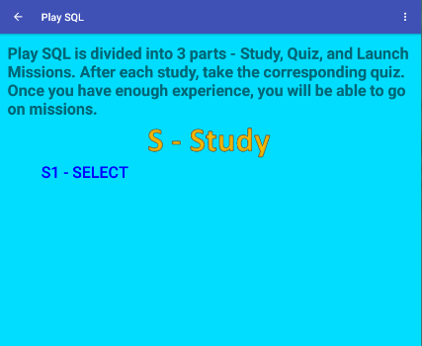
SQL Novice Screen
SIMPSON COLLEGE

Slide 5
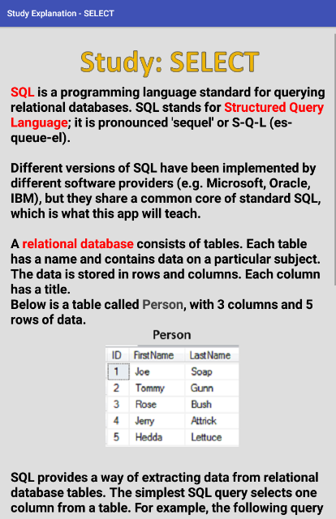
SIMPSON COLLEGE

Slide 6
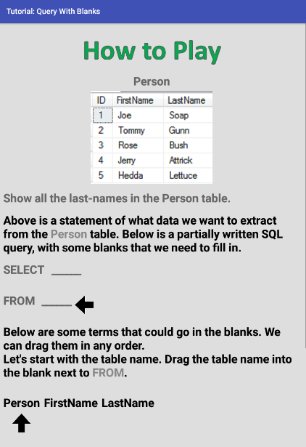
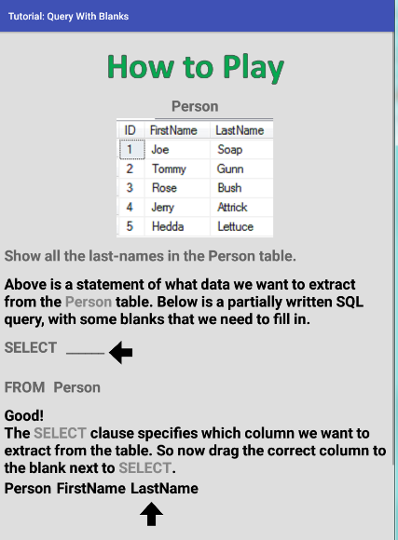
SIMPSON COLLEGE
Tutorial

Slide 7
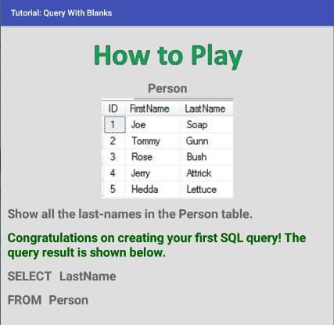
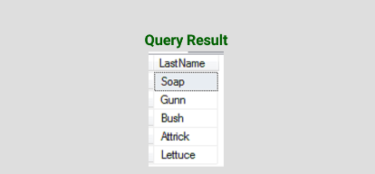
SIMPSON COLLEGE

Slide 8
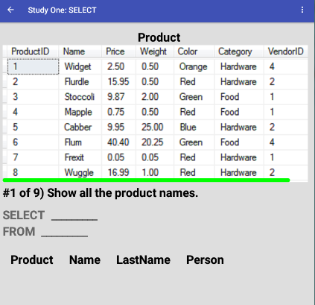
First Query is Easy
SIMPSON COLLEGE

Slide 9
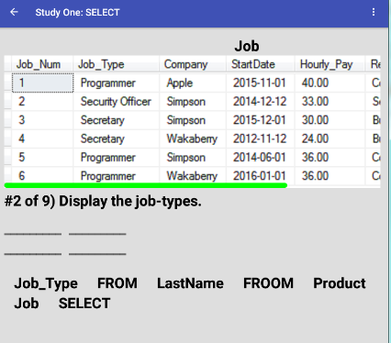
Second Query is Harder
SIMPSON COLLEGE

Slide 10
Content of S1 – Study SELECT
SIMPSON COLLEGE
The study of SELECT continues. Topics covered include:
  How to select more than one column.
  How to select all the columns using SELECT *.
  How to name a column in the query output.
  How to concatenate two or more strings or string columns.

Slide 11
Helpful Features of the App
SIMPSON COLLEGE
User can click button to see solution to any question.
User can go back to previous question.
User can skip remaining questions and go to end of study.
Review screen at the end of each study.
User can take a quiz after studying a section.
  App keeps track of high-scores on each quiz.
Sound effects:
  Applause when query is solved correctly.
  Raspberry for mistakes.

Slide 12
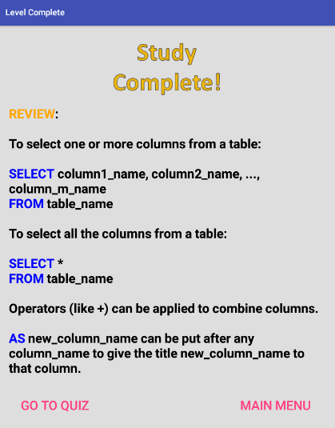
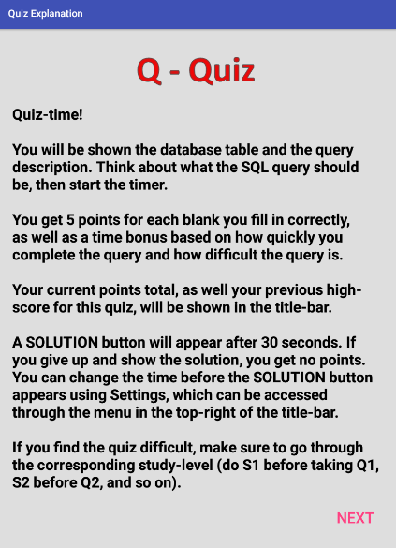
Study Review Screen & Quiz Screen
SIMPSON COLLEGE

Slide 13
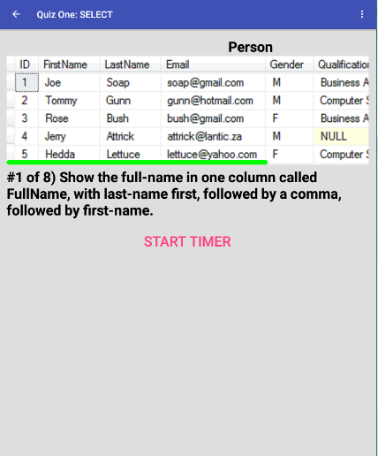
First Quiz Question
SIMPSON COLLEGE

Slide 14
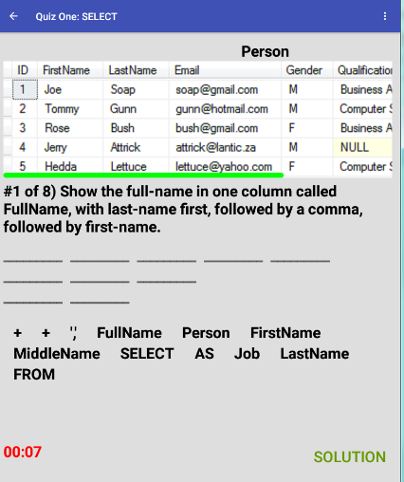
Solve Problem as Quickly as Possible
SIMPSON COLLEGE

Slide 15
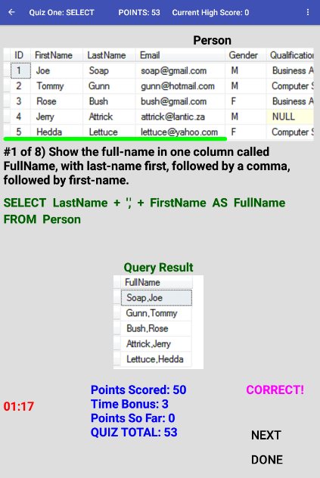
SIMPSON COLLEGE

Slide 16
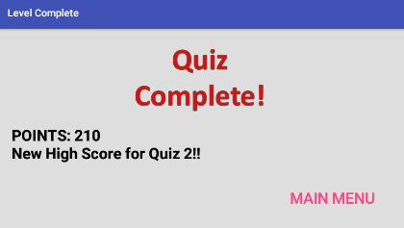
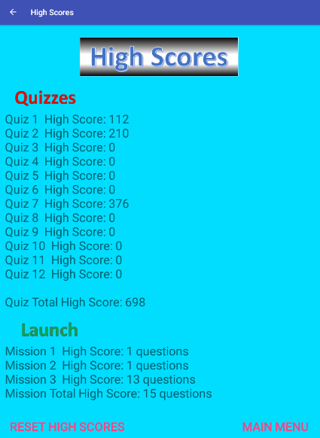
High-Scores
SIMPSON COLLEGE

Slide 17
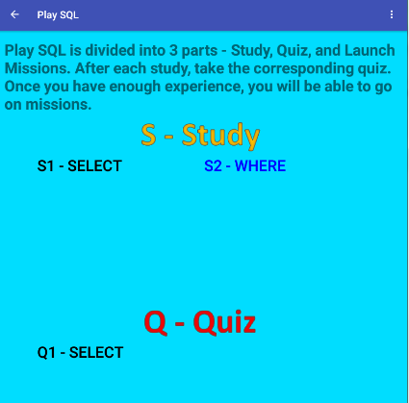
At End of Quiz, App returns to Main Menu
SIMPSON COLLEGE

Slide 18
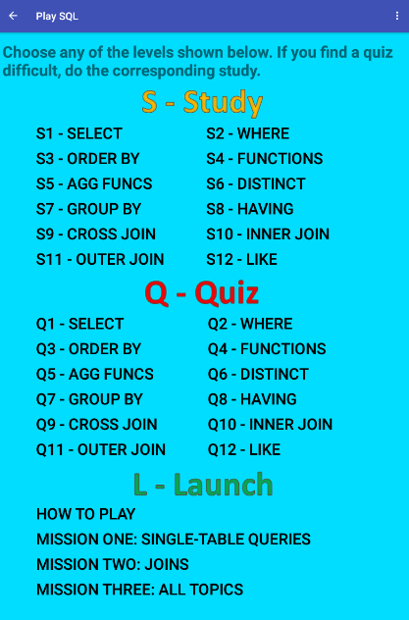
Overview of Entire App
SIMPSON COLLEGE

Slide 19
Ways of Making Queries
SIMPSON COLLEGE
5 different ways of creating queries in the PlaySQL game:
  Dragging terms onto blank places in the query.
  The terms of the query are shown on the screen in random order. The player has to click on them in the correct order.
  The query is shown with errors in it which the player has to correct.
  The query is shown out-of-order. The player has to re-arrange the terms to make it correct.
  Some terms of the query fluctuate randomly. The player has to click on them when they are correct.
These different ways are introduced one-at-a-time as the player progresses through the study material.

Slide 20
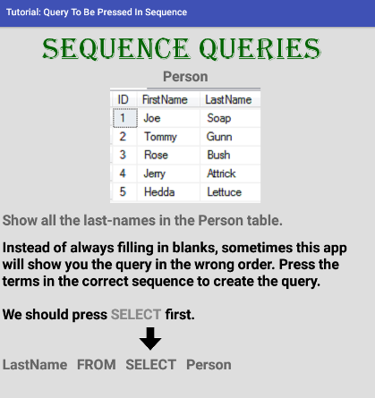
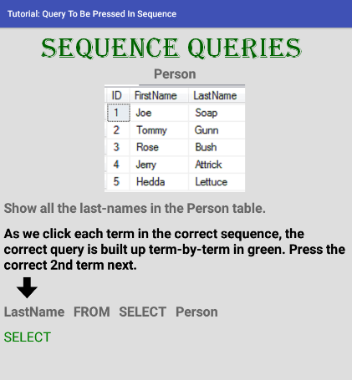
Sequence Queries
SIMPSON COLLEGE

Slide 21
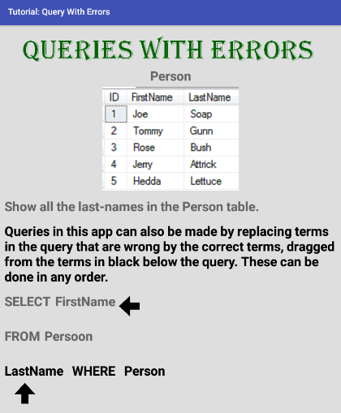
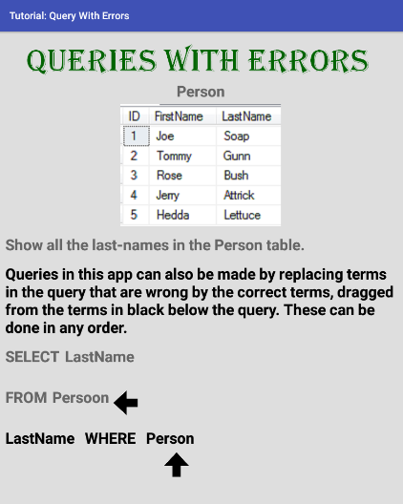
Queries With Errors
SIMPSON COLLEGE

Slide 22
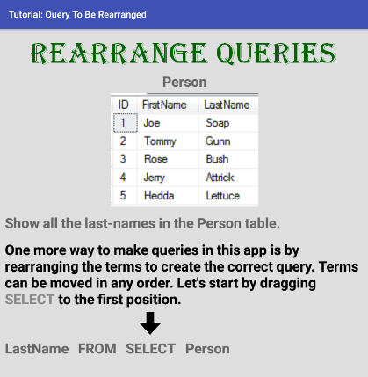
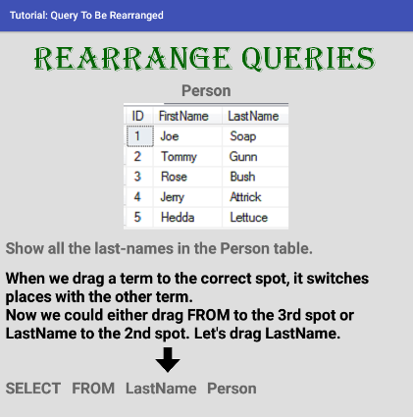
Rearrange Queries
SIMPSON COLLEGE

Slide 23
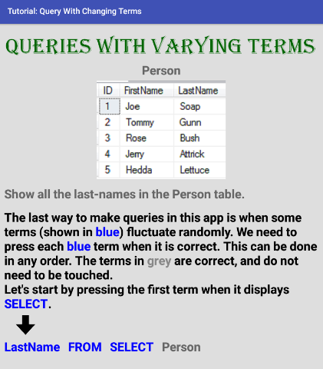
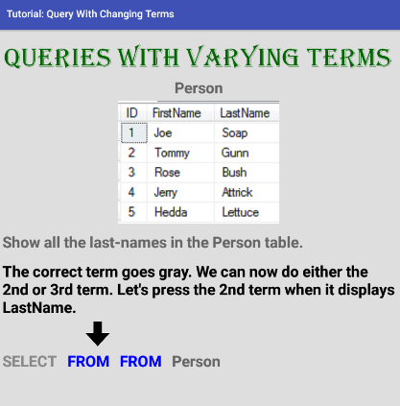
Queries with Varying Terms
SIMPSON COLLEGE

Slide 24
Missions
SIMPSON COLLEGE
After doing Studies and Quizzes, the player can Launch Missions.
Currently 3 missions:
  Single-table queries
  Joins
  All topics
Each mission starts with player having a certain number of lives.
  More lives are given for missions with more questions.
Player tries to complete mission before running out of lives.

Slide 25
How Missions Work
SIMPSON COLLEGE
Each question in a mission has a certain amount of time in which it must be completed.
  Time depends on the difficulty of the query.
  Time decreases as the player progresses further in the mission – game gets harder.
  Question type (blanks, sequence, errors, re-arrange, fluctuating) is chosen randomly.
  If the question is not solved before time runs out, the player loses a life.
  A lost life can be restored if the player solves a later question with sufficient time to spare.

Slide 26
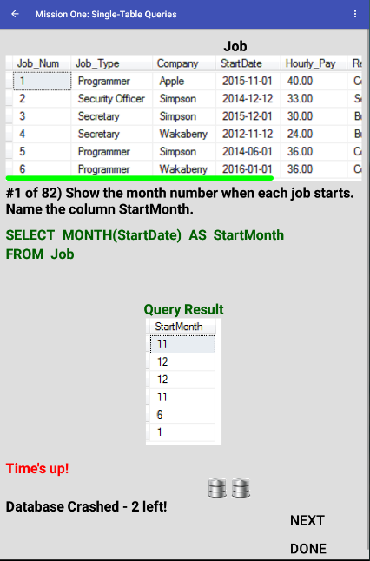
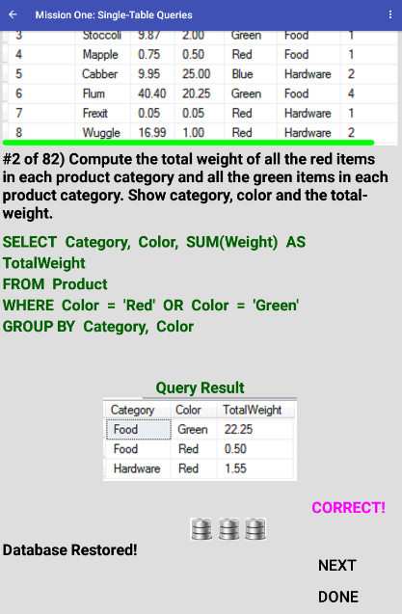
Life Lost (left) and Restored (right)
SIMPSON COLLEGE

Slide 27
Lessons Learned
SIMPSON COLLEGE
Programming is fun! Like, really fun!!!! ☺
Programming productivity has greatly improved.
  Teaching programming makes you a better programmer?
  IDEs are much more helpful.
  Solving problems via the Internet.
  Downloading code from the Internet.
    Bow down to the Git God.
Lots of ideas for improved pedagogy in various classes:
  Databases, Mobile Apps, Software Engineering.

Slide 28
Future Work
SIMPSON COLLEGE
Fix bugs.
Make app work on smaller device sizes.
Make app look more stylish and artistic.
Add more 'gaming' elements.
Include more SQL content.
Decide on whether horizontal or vertical orientation is preferable.
Use in database class.
  Get feedback from a larger user base that uses the app more extensively.

Slide 29
Acknowledgments
SIMPSON COLLEGE
Simpson College, for the sabbatical.
Simpson students who provided feedback as the app was developed:
  Elise Tauer, George Saucedo, Karson Richardson, Ryan Policheri, Kaleb Klepel, Taylor Gehrls, Josh Dietrich, Geoff Converse, Mark Becker, Sam Adeniyi.
The creators of Android's FlexBoxLayout, available on GitHub.

